Slide 1
Predictive Modelling and Analysis of Airfare trends & Ticket Pricing
Divya N

Slide 2

Points Of Discussion:
Problem Statement
Objective of the Project
Understanding Dataset
Data Preprocessing
Exploratory Data Analysis
Data Transformation
ML Model Performance
Conclusion

Slide 3

Problem Statement :
The aviation industry in India is witnessing rapid growth, with multiple airlines operating flights across various cities. However, the prices of air tickets are highly dynamic, influenced by a multitude of factors such as demand, timing, airline reputation, and more. For both airlines and passengers, predicting these prices with accuracy is crucial for maximizing revenue and ensuring affordability.
This project aims to develop a robust machine learning model that accurately predicts the air ticket prices for flights within India. By analyzing data from different airlines and flights between various cities, the model will identify key factors affecting ticket pricing and provide insights to enhance decision-making processes for stakeholders.

Slide 4
Objective:
Develop a predictive model for forecasting airfare trends and ticket prices.
Utilize historical data and machine learning techniques to identify patterns.
Analyze factors influencing ticket pricing within the airline industry.
Enable informed decision-making for consumers and businesses.
Optimize pricing strategies and ticket sales based on predictive insights.
Improve customer satisfaction by enhancing travel planning with cost-effective solutions.

Slide 5

Understanding The Data:
Data Description:
Airline :- The name of the airline company
Date_of_Journey :- The date on which the journey happened
Source :- The city of the departure of the flight
Destination :- The destination city/airport
Route :- The route of the flight from where to where
Dep_Time :- The departure time of the flight
Arrival_Time :- The time of the arrival of the flight to the destination
Duration :- The duration of the flight
Total_Stops :- Total number of stops during the journey
Additional_Info :- Extra/Additional information regarding flight/travel
Price :- The price of the ticket for a single journey

Slide 6
Data Pre- Processing :
Data processing requires cleaning of data and preparing it for further analysis. Our cleaning process involve the following parts:
Necessary libraries such as pandas, numpy, matplotlib, and seaborn are imported.
We observe 2 missing values, I can directly drop these, as these are very less
Checked for duplicates and dropped the Duplicates
The datatypes of Date_of_journey, Arrival_Time and Dep_Time is object. So, firstly we convert it into date and time for proper prediction.
dt.day method will extract only day of that date and dt.month method will extract only month of that date
Now ,we extract day and month from Date_of_journey and stored in 2 other columns.
From Arrival_time and Dept_time features, we extract hour and minutes and stored in new columns and drop these columns
Lets Apply pre-processing on duration column, Separate Duration hours and minute from duration
We are using two main Encoding Techniques to covert Categorical data into some numerical format
As there is some outliers in price feature, so we replace it with median

Slide 7
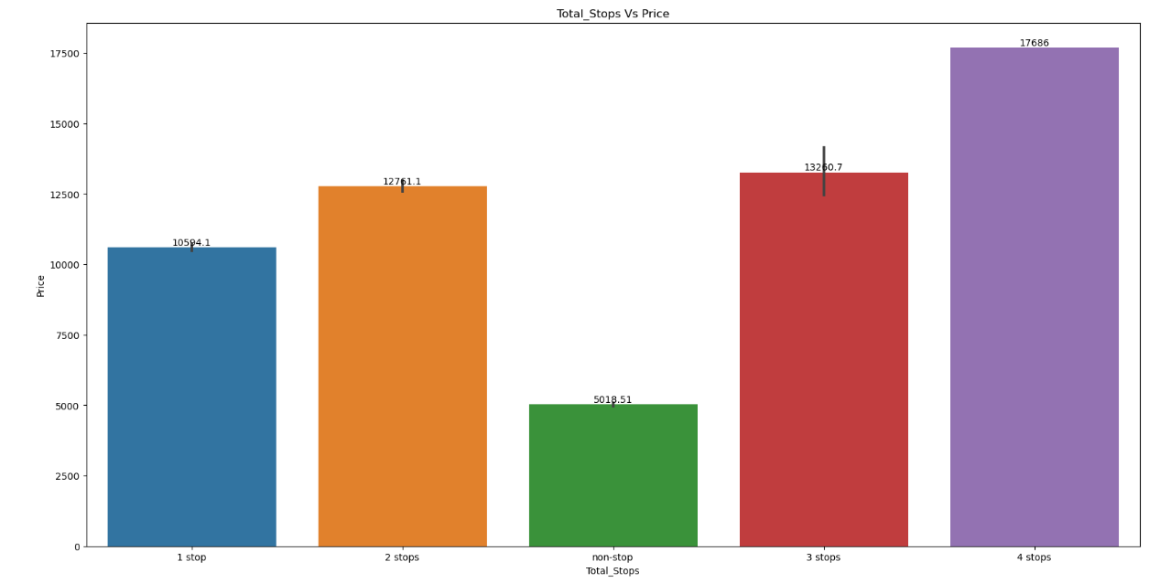
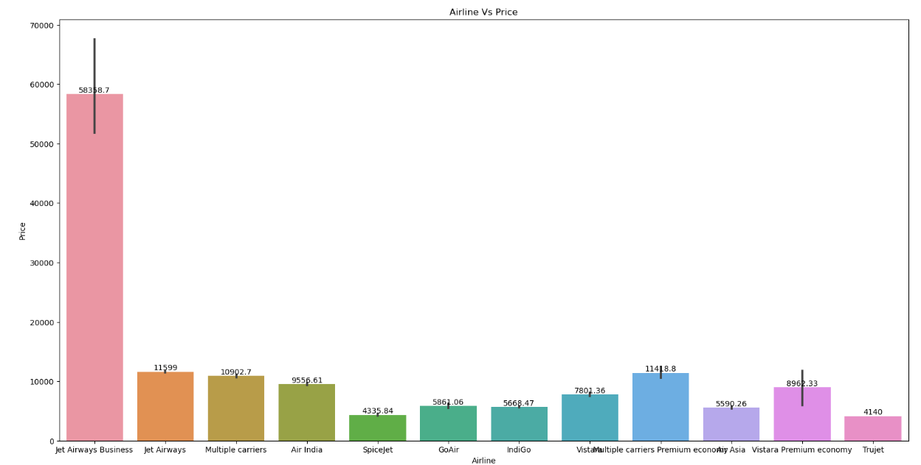
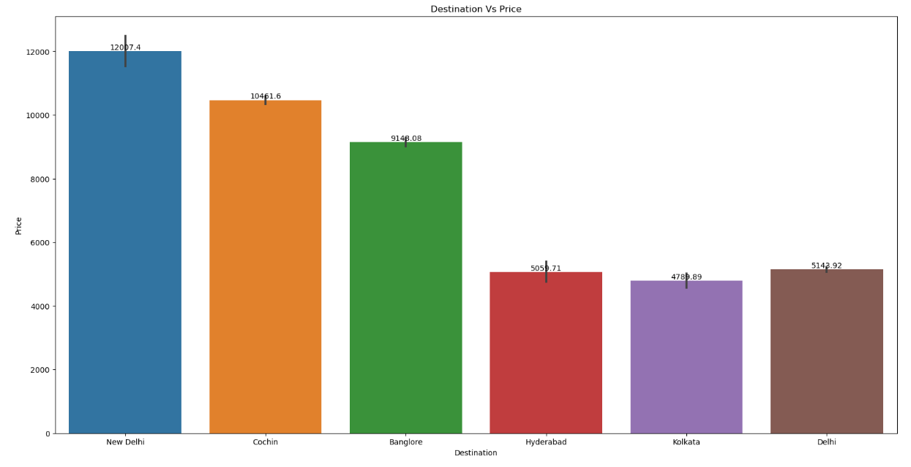
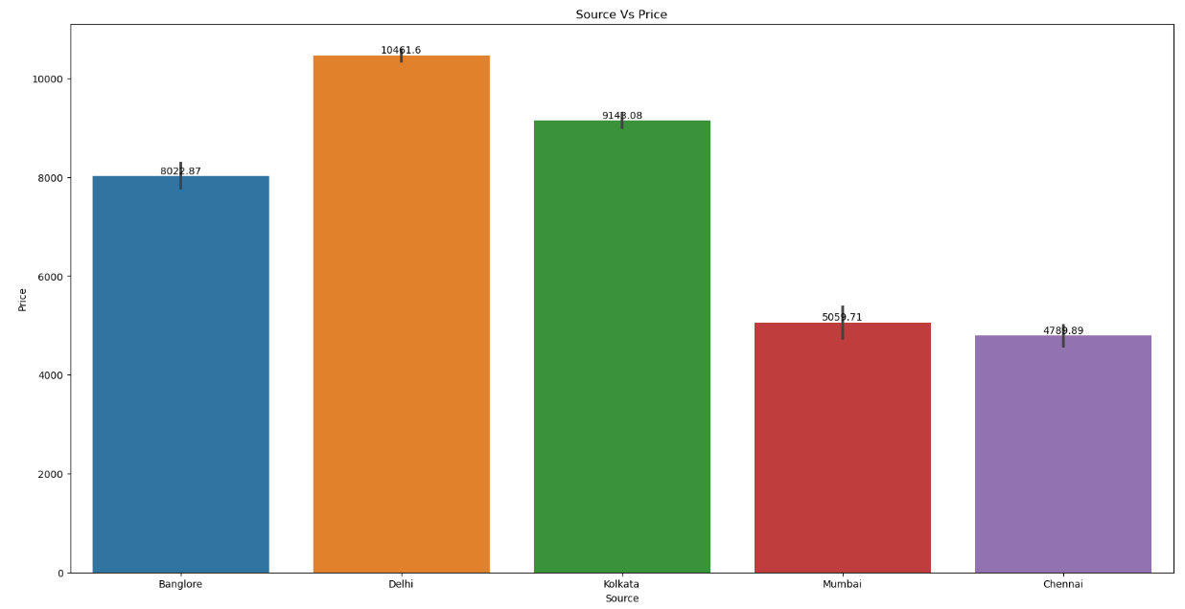
Data Visualization:-
Total Stops Vs Price
Airline Vs Price
Destination Vs Price
Source Vs Price

Slide 8
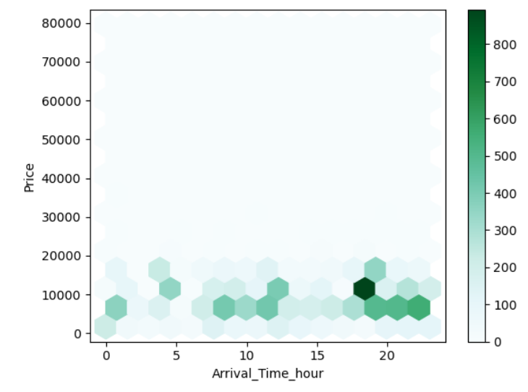
Data Visualization:-
Arrival Time Vs Price

Slide 9

Data Splitting:
Train-Test Split:
Chose an 80-20 split for the dataset.
Allocated 80% of the data to the training set to capture enough patterns and relationships for model training.
ML Model Selection:
Implement multiple machine learning algorithms LogisticRegression, KNeighborsRegressor, DecisionTreeRegressor, GradientBoostingRegressor, RandomForestRegressor , with regression techniques
Evaluated model performance using metrics such as R-squared score, means square error, Mean absolute error and root mean square error

Slide 10
Model Performance:
Comparison of Models: Table for comparing the performance metrics of different models.
S.no | Regressions | MAE | MSE | RMSE | R2 Score
1. | Random Forest Regressor | 1135.6 | 3310150.6 | 1819.3 | 0.82(0.84)
2. | Logistic Regression | 1995.9 | 11292077.6 | 3360.3 | 0.39
3. | Kneighbors Regressor | 1710.2 | 6651134.7 | 2578.9 | 0.64
4. | Decision Tree Regressor | 1322.02 | 5577573.3 | 2361.6 | 0.70
5. | Gradient Boosting Regressor | 1455.06 | 4056829.9 | 2014.1 | 0.78
After performing various regression techniques on our predictive model and we found out that Random Forest Regression has performed better than any other regression model with 82%, and after hypertuning we got 84%.

Slide 11
Conclusion:
The project successfully developed and implemented predictive models that accurately forecast airfare trends and ticket pricing. By analyzing historical data and identifying key factors influencing price fluctuations, the models provided valuable insights that can be used to optimize pricing strategies. These insights empower stakeholders in the airline industry to make data-driven decisions, improve revenue management, and offer competitive pricing to customers. The project demonstrates the effectiveness of machine learning techniques in predicting complex market behaviors and highlights the potential for further enhancement of predictive capabilities in the future.

Slide 12


